Slide 1
DAMG-6210 Group 4 Wireless Handset (Phone) Repair Service Factory Database
Members:
Sung Hoon Ko, Tzu Hui Fang, Benson Babu Mathew, Steven Yang

Slide 2
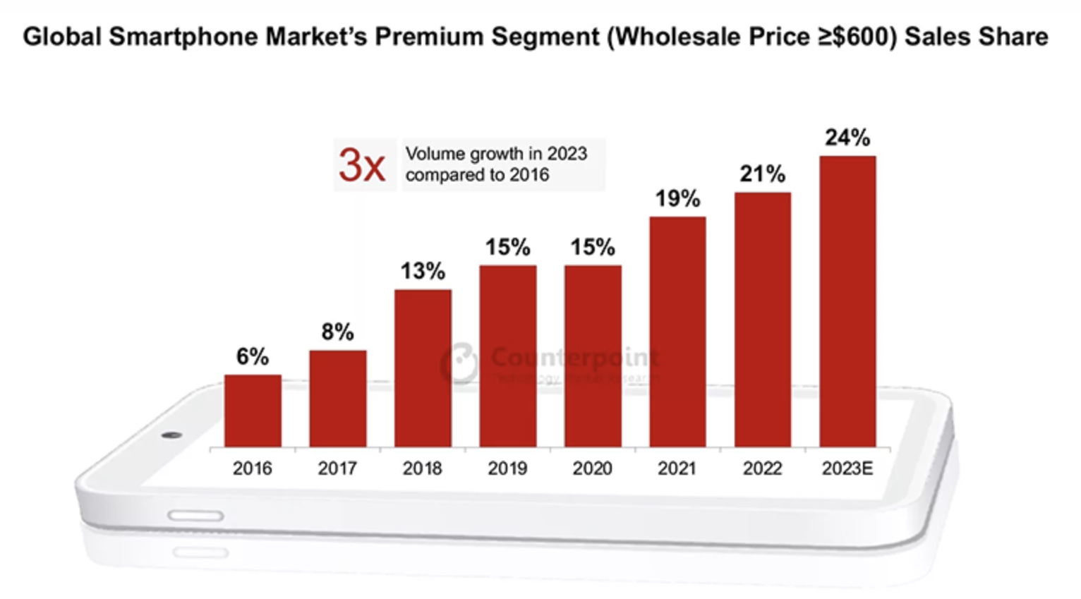
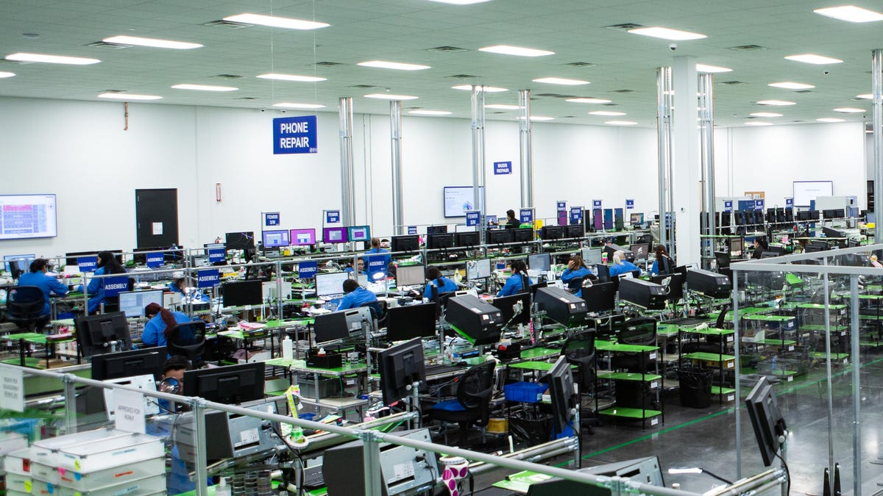
Our Database Mission
As smartphone becomes more and more popular, the database for repair control is also increasingly necessary.
Our mission is to ensure that the wireless handset repair and refurbishment process has end-to-end traceability by creating a powerful database structure.
We use the concepts from DAMG-6210, such as ERD, normalization, and SQL coding, to complete this project.
*Picture is from CounterPoint
*The repair floor at Samsung's mail-in repair facility in Irving, Texas.

Slide 3
Overview of Our Project
The factory database for the Wireless Handset (Phone) Repair Service is designed to manage and optimize the handset repair process.
Our database handles customer and employee information, parts storage, process stages, shipping control, payment, and even customer feedback.
Our database has set up three functions to help clarify things quickly, including customer satisfaction levels, parts cost and shipping priority.
Create several views to access more comprehensive information, such as repair history, payments over $100, etc.
Factory Database
Personal information: name, phone number, address...
Parts storage control: each parts in each warehouses
Process stages: repair, quality inspection, facility, customer service, etc.
Payment: cash, credit card, paypal
Survey
Functions
Views

Slide 4
How Our Project Database was Designed
Our project uses a relational database model, which is implemented using SQL.
There are several stages before creating a database:
Collect information and brief process flow.
Define Database Schema.
Create ERD by using Lucid chart.
Normalize ERD(1NF, 2NF, 3NF).
Creating our database :
Create tables and define data types.
Insert over 10 rows into each tables.
Create constraints.
Create views/functions

Slide 5
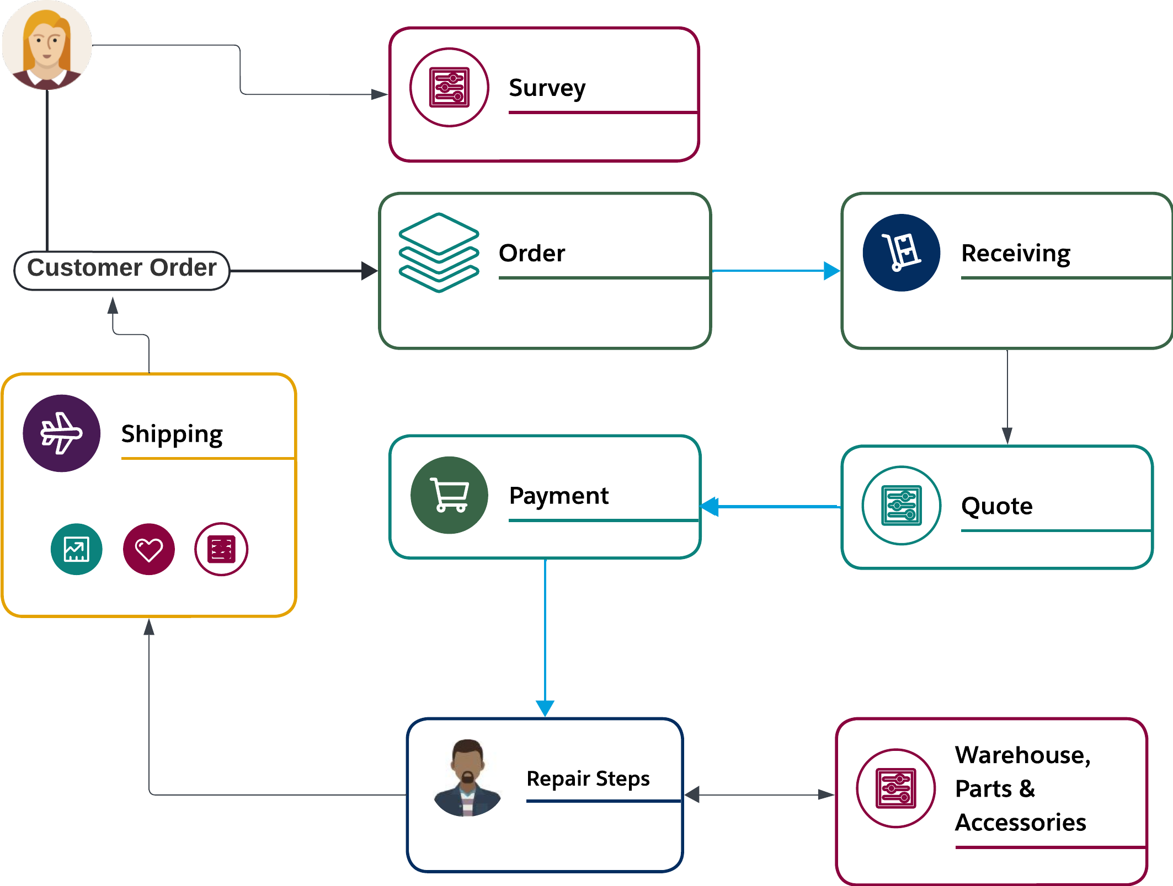
Business Flow

Slide 6
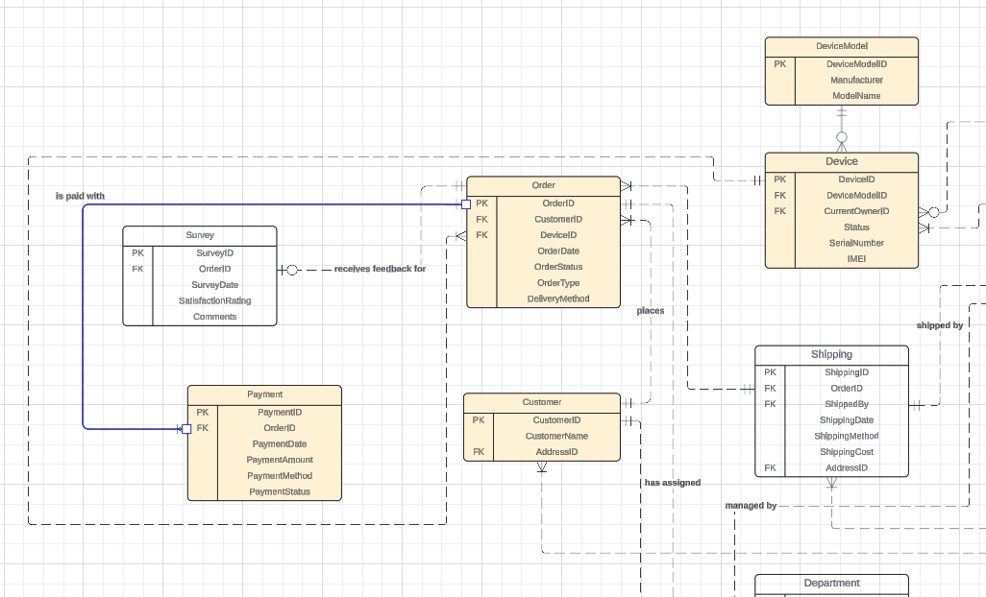
Customer places an Order
a. With the Device information for repairing. b. Create the Payment that belongs to the Order. i. An Order should have at least one Payment (Customers must pay when they place an order or set up payment plans)

Slide 7
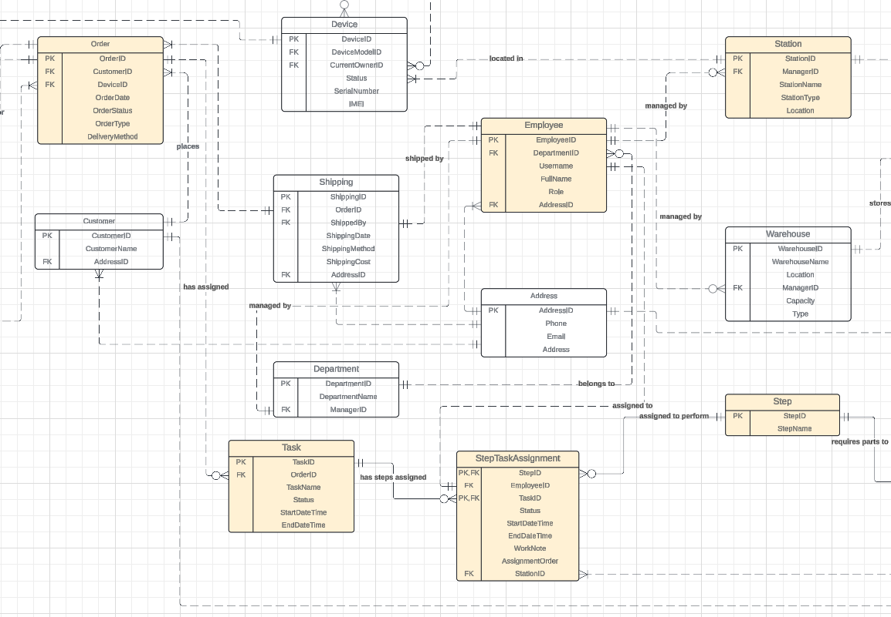
System will generate Tasks for the Order
a. An Order can have zero Task. b. We can track where the Device is by checking the latest StepTaskAssignment of the Order. c. Each StepTaskAssignment has a relationship with an Employee who is responsible for working on the Step. d. Each row in the Step table represents a pre-defined step to complete a Task. i. For example, Pre-repair quality control, all kinds of steps for repairing, post-repair quality control, and shipping could all be a row in the Step table. ii. When all the related StepTaskAssignment(s) are completed, then we can consider the Task is completed

Slide 8
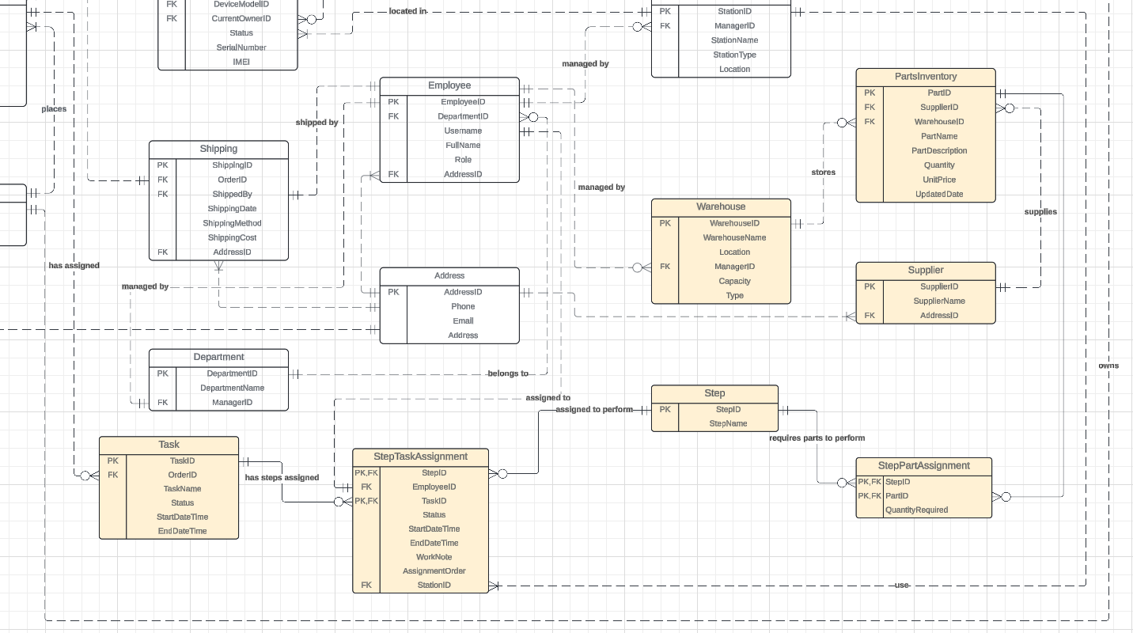
The Parts that require to complete the Step
e. StepPartAssignment uses a Step to link its relationship to the PartsInventory that are needed to finish the Step (using StepPartAssignment) i. PartsInventory will be assigned to a Warehouse. f. A Station will assign to a StepTaskAssignment, so that an Employee can handle the StepTaskAssignment at a Station. g. A Customer’s Device can be swapped for a new device (e.g. trade in, refunding), so the current owner might be transferred to the new device.

Slide 9
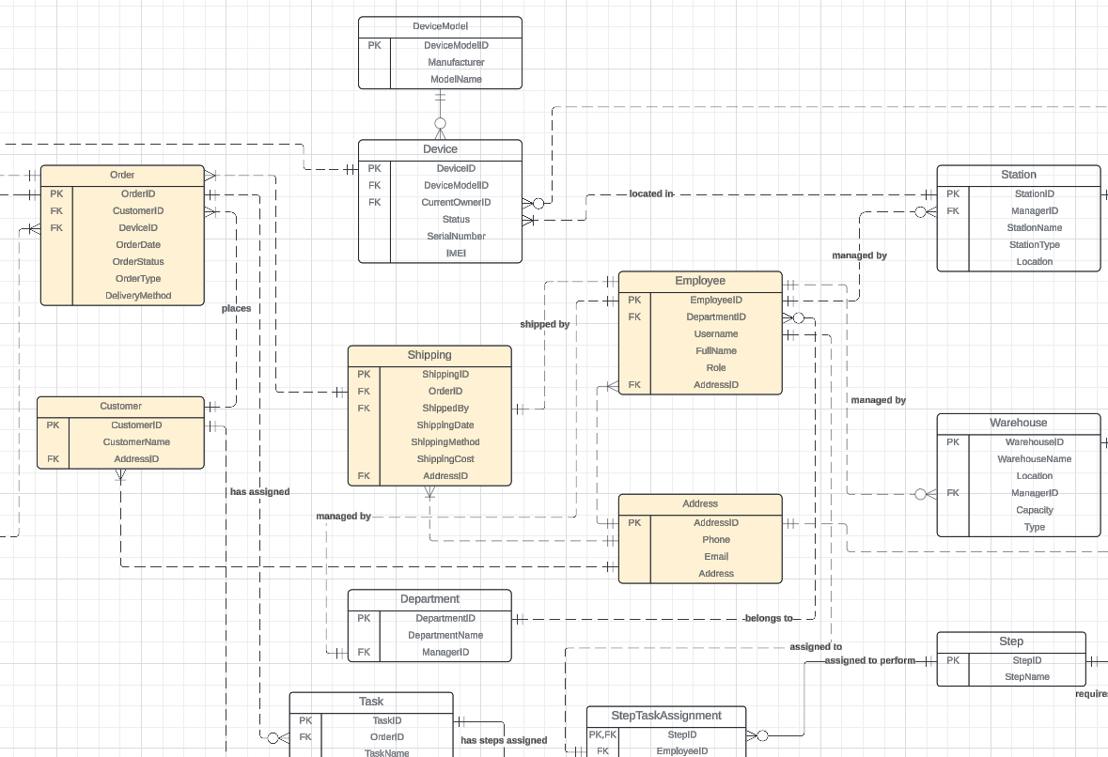
End of the Tasks and Steps
When all the related Task(s) are done, a Shipping record will be created to ship the Device back to the Customer a. This does not apply to the Order(s) end up with refunding.

Slide 10
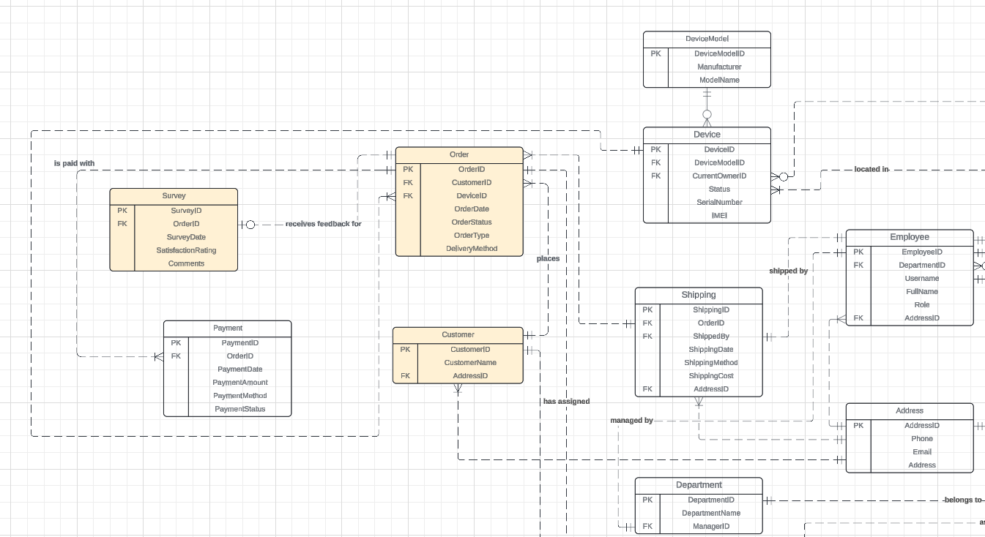
End of the Order
Customer can submit at most one Survey after a service is completed a. The submission of a Survey is not mandatory, so an Order could have zero Survey.

Slide 11
More About Entity Relations

Slide 12
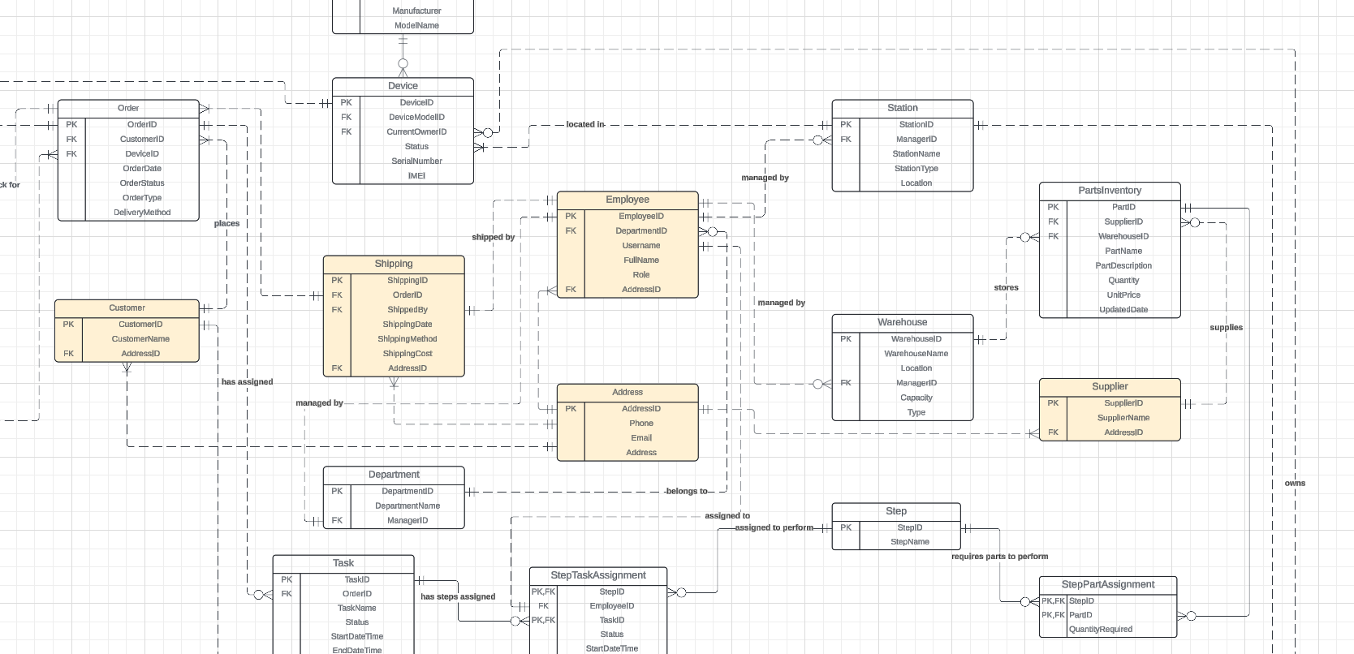
Adress
Adress entity is related to multiple entities

Slide 13
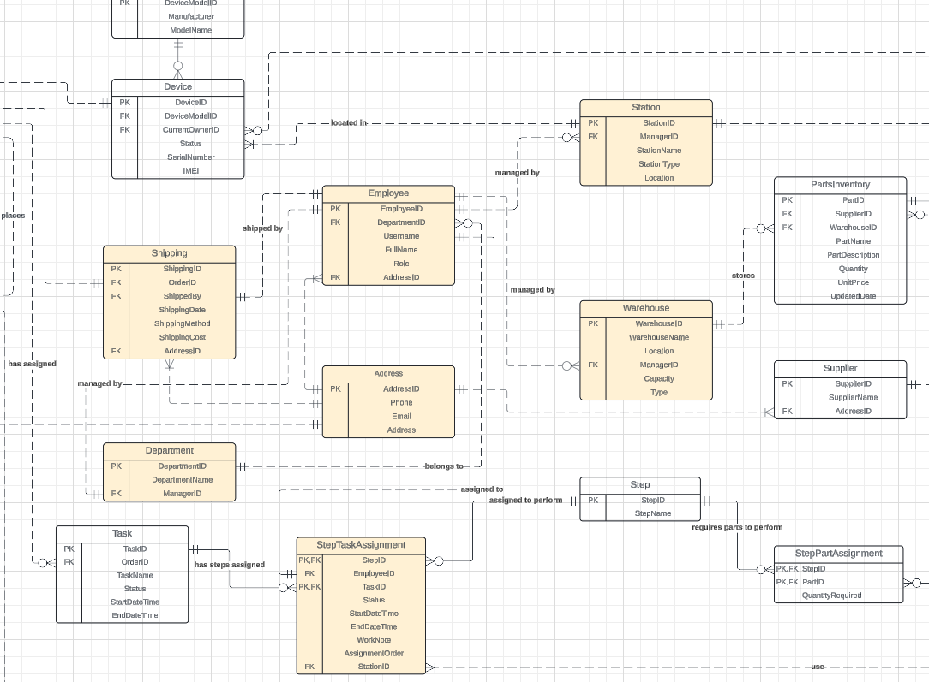
Employee
Employee entity is related to multiple entities

Slide 14
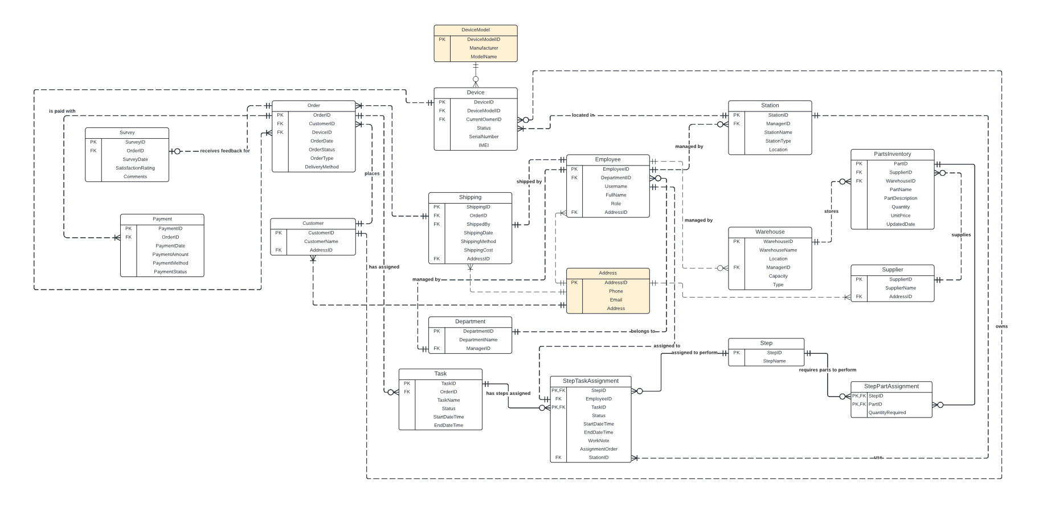

Slide 15
Create Database

Slide 16
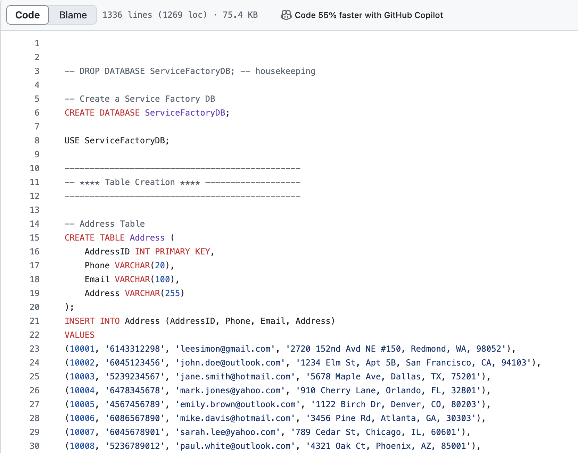
Create database
We use GitHub for version control, and create new database : ServiceFactoryDB.
Create individual tables based on the ERD.
Insert into over 10 rows of data in each table.
Define the data type for each attributes.

Slide 17
Database Constraint

Slide 18
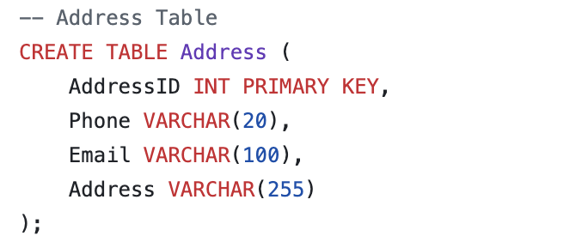
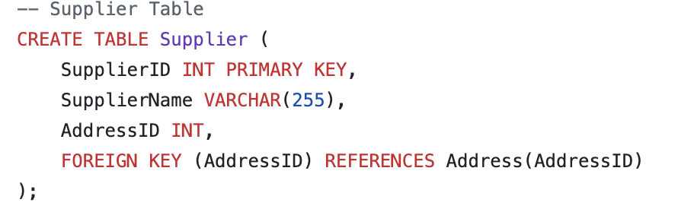
Primary key vs Foreign key
It is necessary to ensure the relationship between the primary key and foreign key in different tables.
Take the Supplier table as an example: There is a foreign key, AddressID, which also serves as the primary key in the Address table.

Slide 19
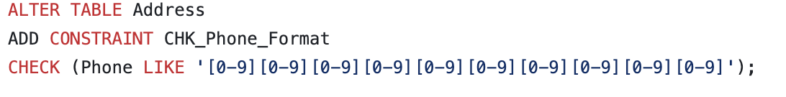
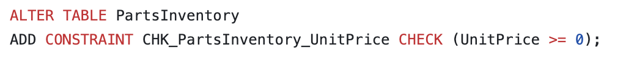
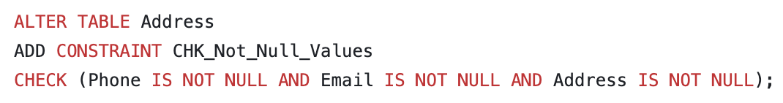
Table level constraint
Check constraint
Check constraint : Ensures that an attribute can only store values that meet a specific condition
Not Null constraint : Ensures that an attribute cannot have a "Null" value.
Not Null constraint

Slide 20
View Demo

Slide 21
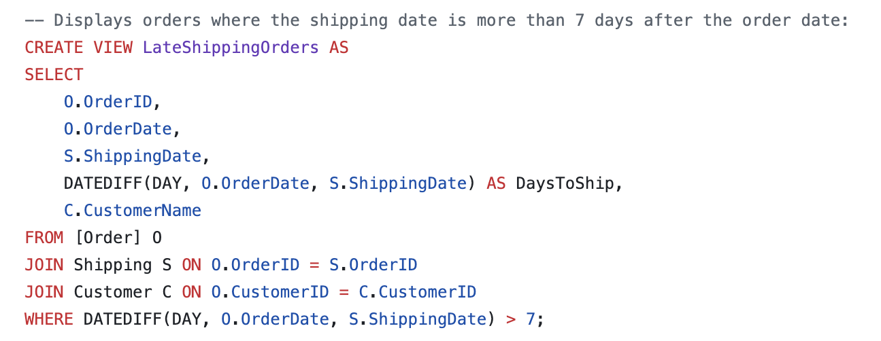
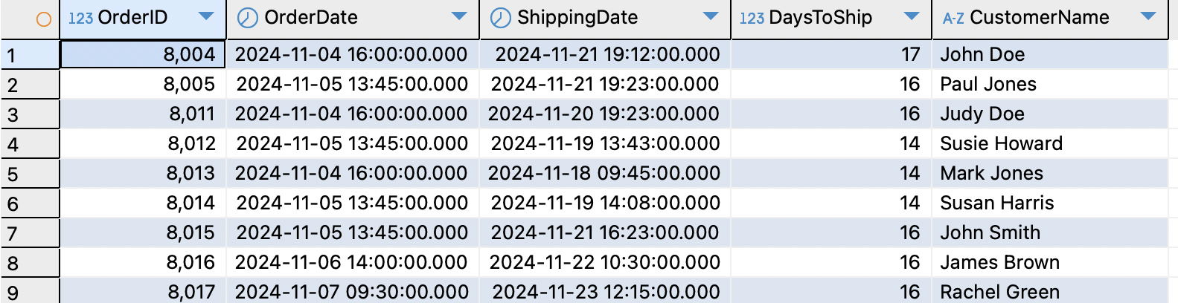
View 1
List the orders where the shipping date is more than 7 days after the order date.

Slide 22
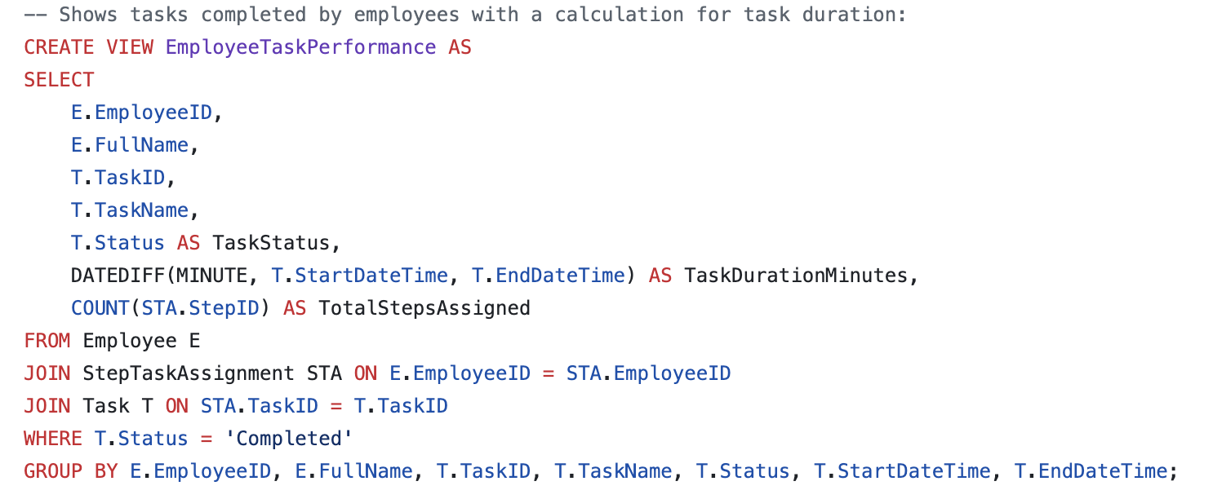
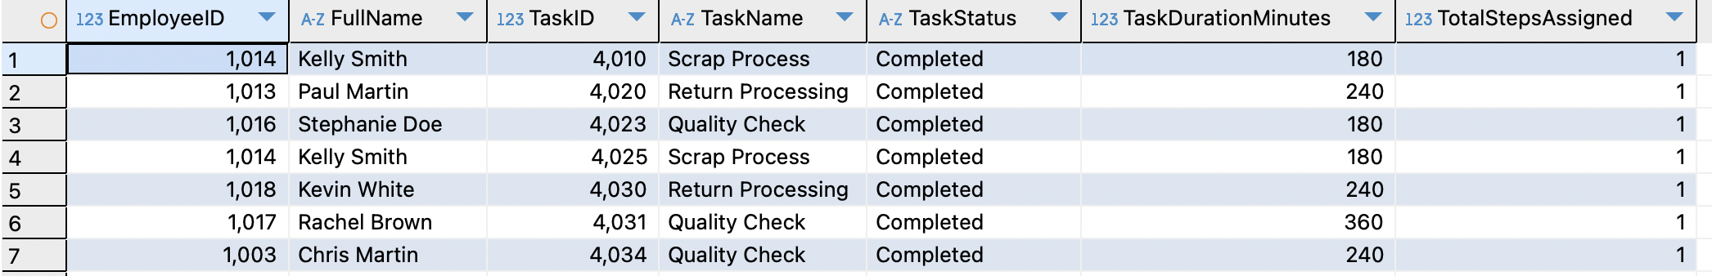
View 2
Track the tasks completed by employees and list the detailed information.

Slide 23
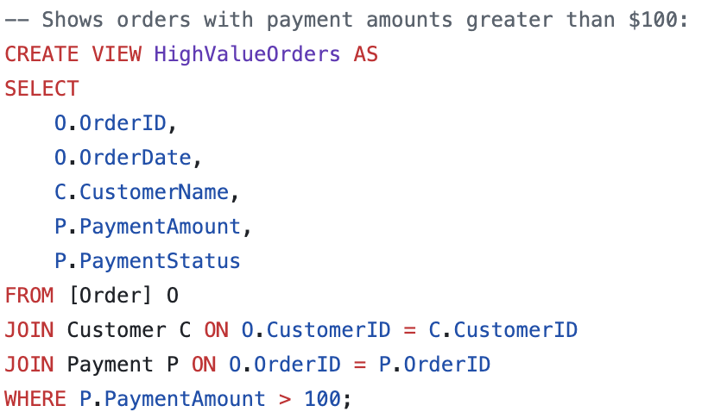
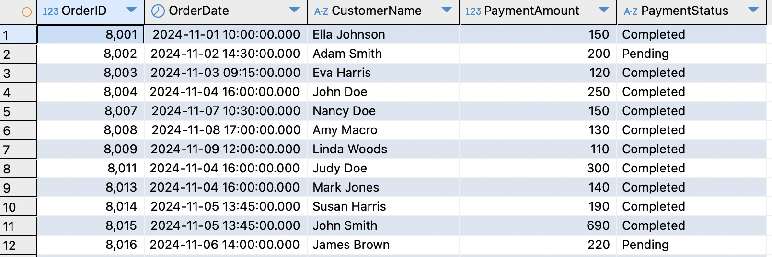
View 3
Highlight the payment amounts greater than $100 and the payment status.

Slide 24
Function Demo

Slide 25
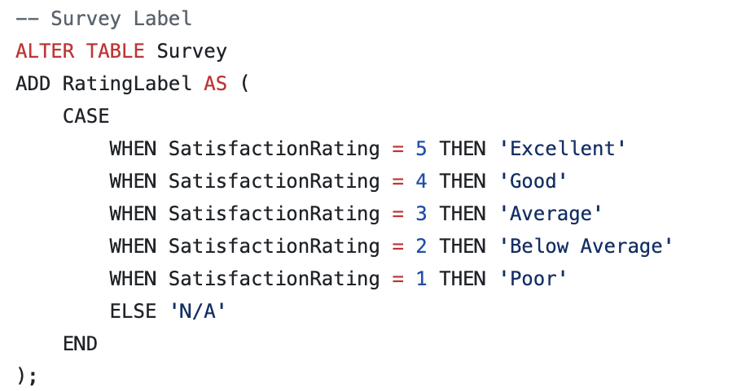
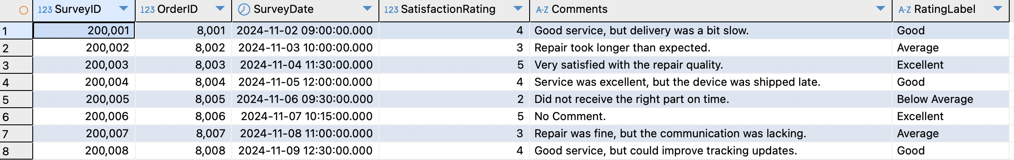
Function 1
Add a comment after the rating in the Survey table.

Slide 26
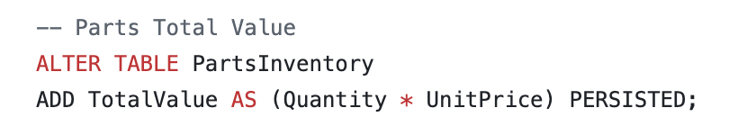
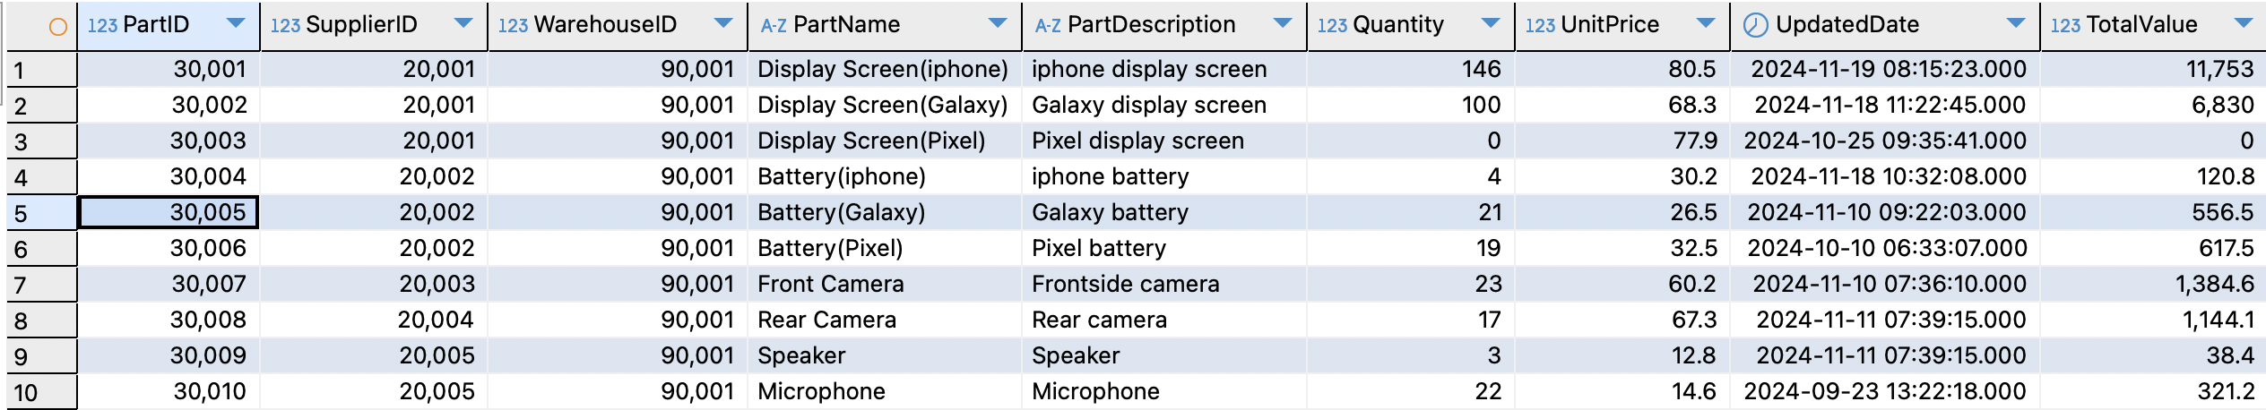
Function 2
Calculate the total value of parts in different warehouses.

Slide 27
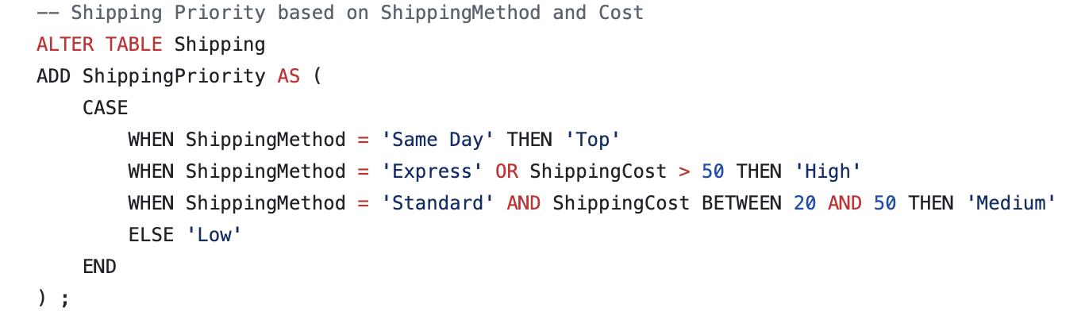
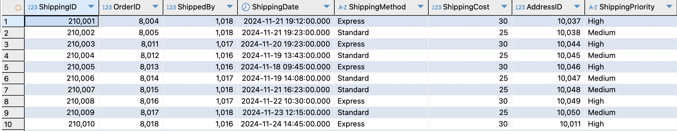
Function 3
Highlight the shipping urgency by shipping method.

Slide 28
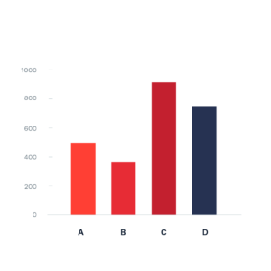
Reports and Visualizations

Slide 29
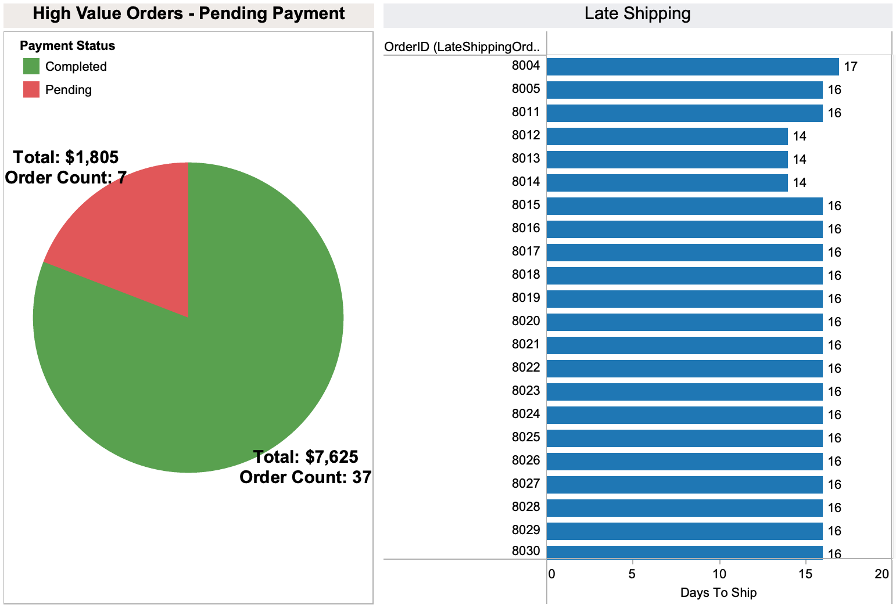
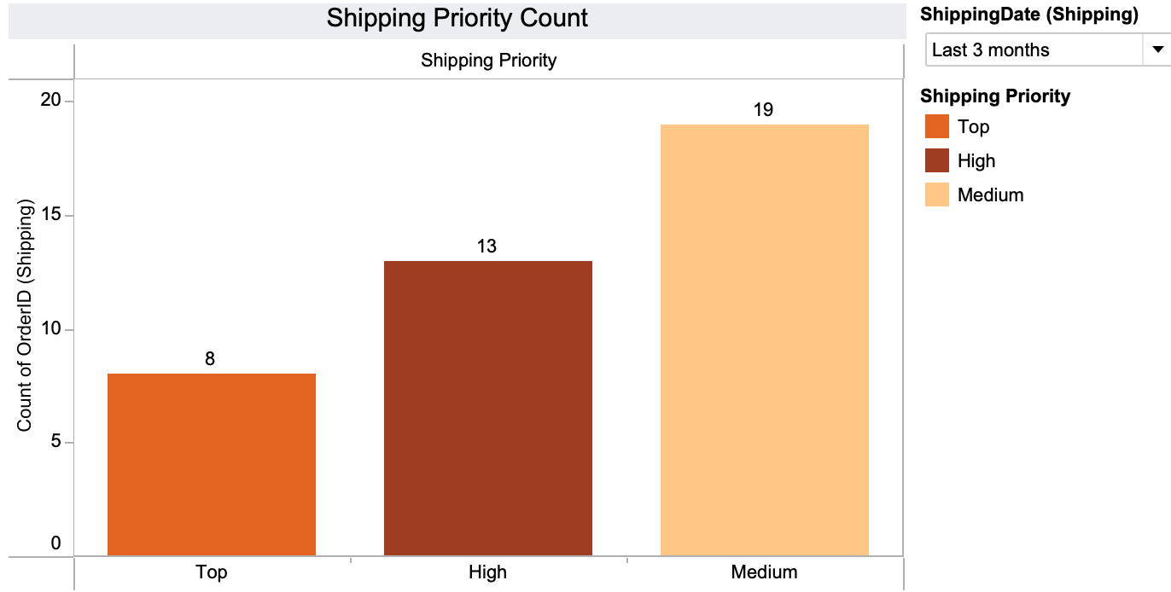
Payment and Shipping
(a)
(B)
Pending Payment Chart
Late Shipping (Days to Ship) per order
Shipping Priorities Count
(C)

Slide 30
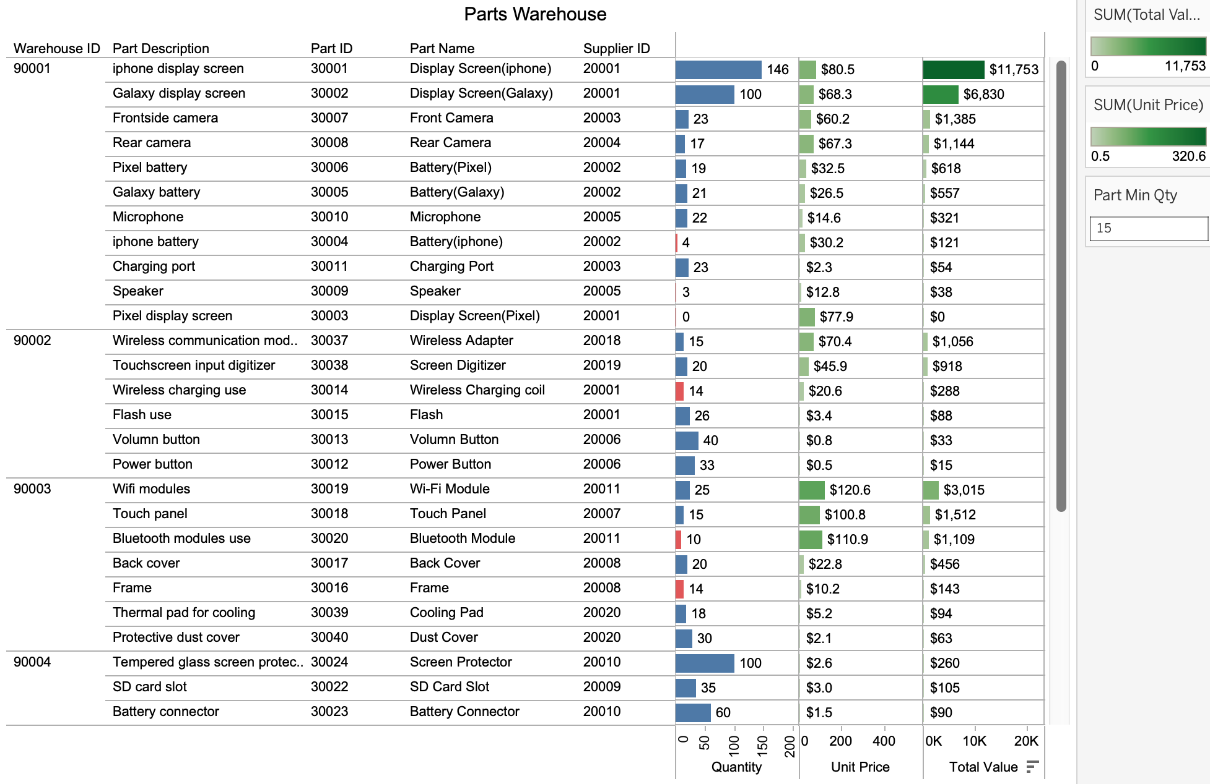
Warehouse Parts
Quantity
Unit Price
Total Value
Qty x Price
(a)
Parts Warehouse Parts Quantity (Min Qty < 15)

Slide 31
Potential implications for the industry/field

Slide 32
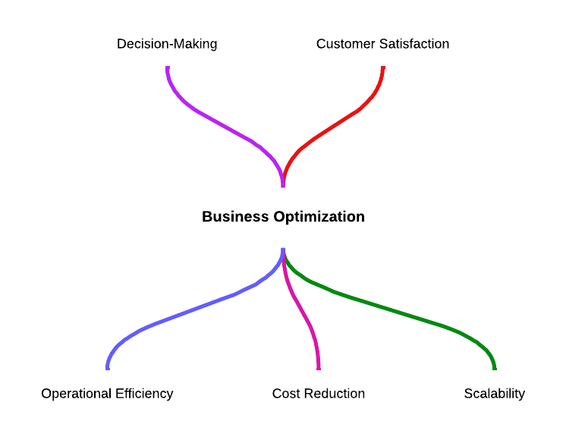
Factory Database - Potential Implications for the industry/field
1. Increased Operational Efficiency
Streamlined workflows for managing suppliers, inventory, shipping, and employees reduce redundancies and improve process efficiency.
2. Better Decision-Making Through Data
Real-time metrics enable faster, more accurate, and data-driven decision-making.
3. Scalability and Adaptability
Enables expansion into new services or additional factories by leveraging the database's flexibility and extensibility.
4. Enhanced Customer Satisfaction
Accurate, real-time order tracking fosters better communication with customers and strengthens trust.
Optimized shipping operations ensure on-time deliveries, reducing delays and improving the overall customer experience.
5. Cost Reduction
Efficient resource management minimizes operational costs, such as overstocking or delayed shipments.
Proactive tracking of late shipments mitigates penalties and prevents reputational damage.

Slide 33
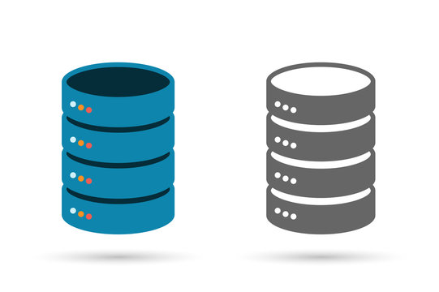
Conclusion
By leveraging concepts from DAMG-6210, we:
Designed an ERD structure to organize and relate critical data efficiently.
Applied normalization to enhance data integrity and reduce redundancy.
Developed robust SQL queries for seamless data retrieval, analysis, and reporting.

Slide 34
Thank you!

